Slide 1
Opinion Engine
Powered by team #sentiment

Slide 2
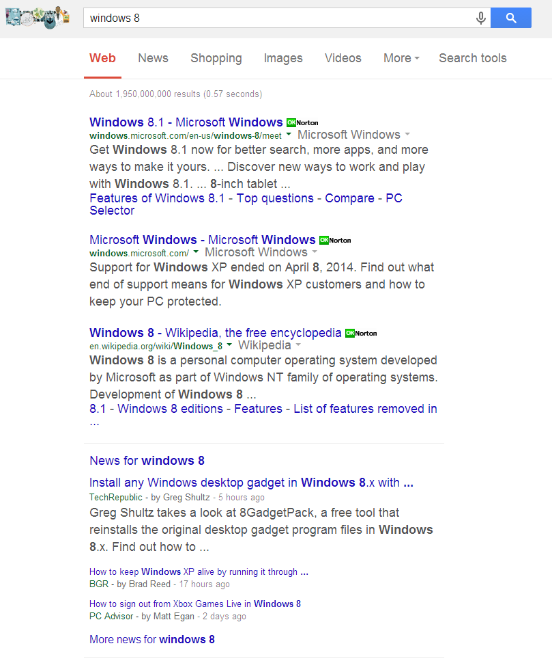
Problem with search
Lacks emotion
Fact-lookup in nature
Treats text as objective in nature
No good way to handle searches that want opinion
Movie reviews, product searches, etc…

Slide 3

Our Solution
Allow you to include your feelings in the search query
Give you results that are based on your feelings
Create an Opinion Engine
Social media is full of opinions
Many web articles tend to be subjective (movie reviews, news articles, etc…)

Slide 4
How it works
You enter a query with your opinion towards something
Sample Query: I love pizza
We scan through Twitter and Bing results with the subject of your query
In this case the subject is pizza
Engine returns Twitter’s sentiment toward that subject
Includes sample tweets
Engine returns whether Bing agrees or disagrees with you

Slide 5
How it works – Query Parsing

Slide 6
How it works – API’s
Twitter API
Takes query and returns relevant tweets
Bing API
Takes query and returns relevant web links
Alchemy API
Takes unstructured data (tweets, webpages) and returns a sentiment score

Slide 7
How it works – Emotion analysis
Repurposed Naïve Bayes classifier from assignment 3
Determines the emotion of a body of text
Trained it on twitter hashtags (#happy, #sad, …)

Slide 8
How it works – Determining Results

Slide 9
Demo

